Slide 1
Welcome to Online-Auction
This online auction project
Directed by: shantonu roy
Junior instructor
(computer) spi
Submitted by: Md salman sha sun
Roll:372722, 5/cmt/a₂

Slide 2
What is an auction?
• Auction is an process of buying and selling goods or services by offering them up for bid, taking bids, and then selling the item to the highest bidder.
• Its a billion dollar industry and emerging on and on as there are many industries, countries and places or domains where auctions are not used.
• An auction is generally an event in which goods are sold to the highest bidder. By being open to the public, an auction ensures a wide range of bids, and sometimes items at auction can fetch surprisingly high prices. The bidders, in turn, create their own market, determining on an individual basis how much they want to pay for an item, rather than having prices dictated by the seller. There are a number of types of auctions performed around the world.
• Auctions are used to sell many things in addition to antiques and art. All around the world there are auctions of commodities such as tobacco, fish, cattle, racehorses, and just about anything else where there's a market of multiple people interested in buying the same thing. That's the key to an auction - a bunch of people who are interested in buying the same object, and taking turns offering bids on the object. The right to buy that object will go to the highest bidder.

Slide 3
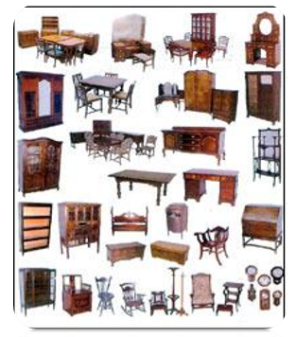
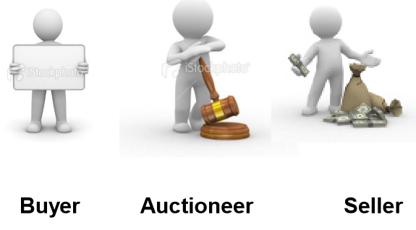
Traditional Auctions
• Auctions are used to sell many things in addition to antiques and art. All around the world there are auctions of commodities such as tobacco, fish, cattle, racehorses, and just about anything else where there's a market of multiple people interested in buying the same thing. That's the key to an auction - a bunch of people who are interested in buying the same object, and taking turns offering bids on the object. The right to buy that object will go to the highest bidder.
• USERS INVOLVED in traditional auction
– SELLERS
– BUYERS
– AUCTIONEER

Slide 4
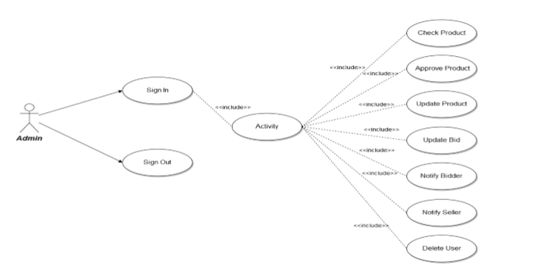
Use Case Diagram for Administrative panel
Functionalities provided:
Check Product: Admin can check products
Delete Product: Admin can delete products
Update product: Admin can update products
Update Bid: Admin can update bid status
Notify: Admin can notify bidders and sellers
Delete user: Admin can delete users

Slide 5
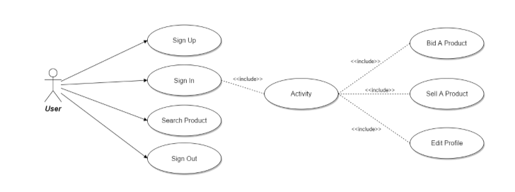
Use Case Diagram for User panel
Functionalities provided:
Register: user need to sign up first to add or bid a product into the site
All product: user can see all product pages
Product details: user can see the product details
All category: user can see all the categorized products
Total items: user can see their total uploaded and bided items on the page
Edit Profile: User Can Edit their profiles

Slide 6
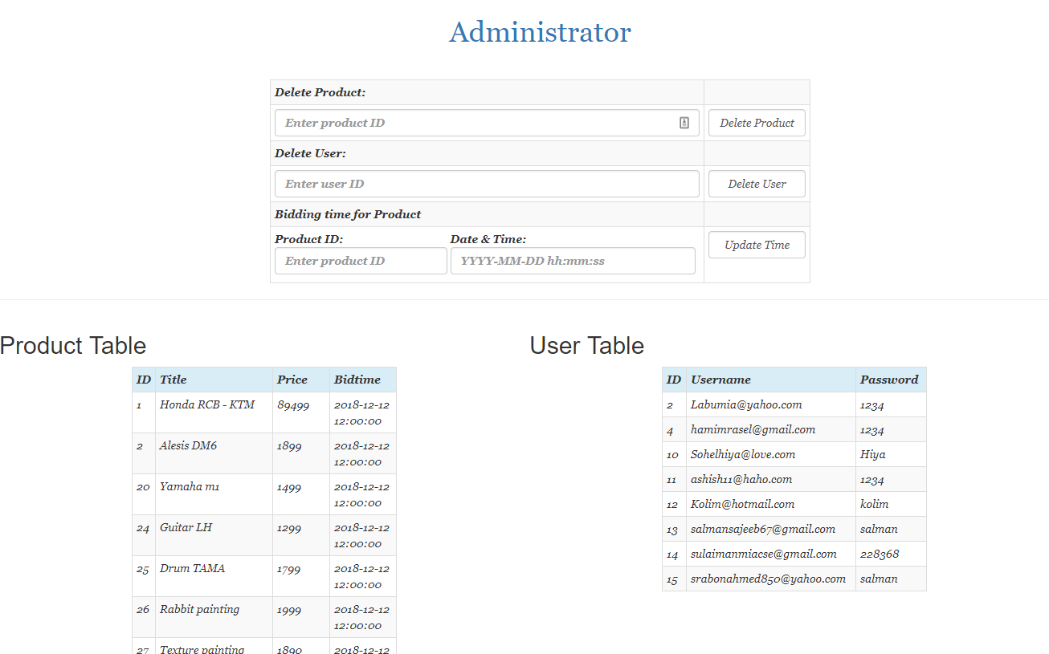
Admin interface:
Description: By this page admin can see all the system summary. Admin can delete user, delete product and update. Admin can update biding time hear.

Slide 7
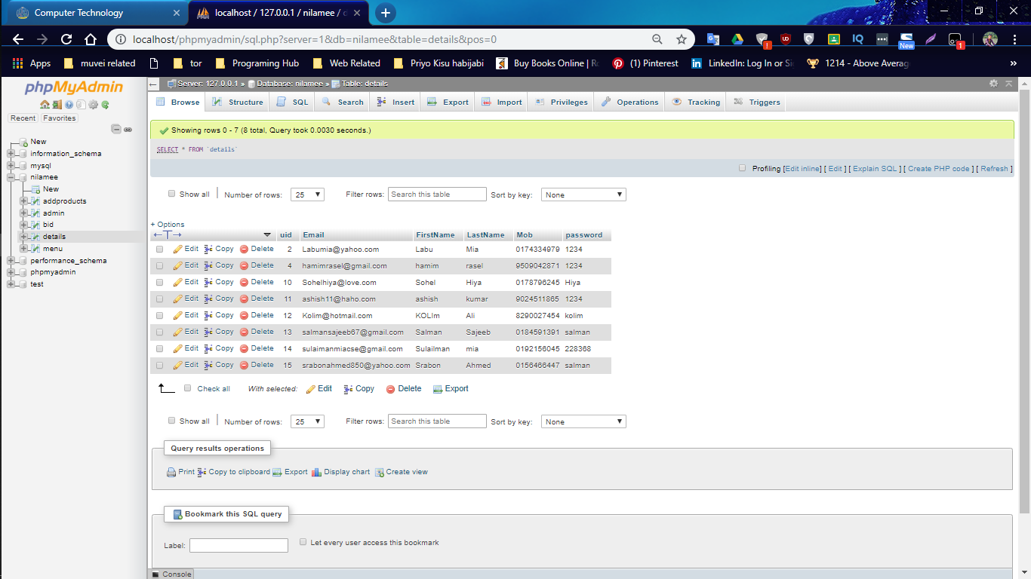
Database Interface
Purpose: Users Information Table
Description: This table will contain the user information. Users are who is using this system. This table will be using for authentication of users.

Slide 8
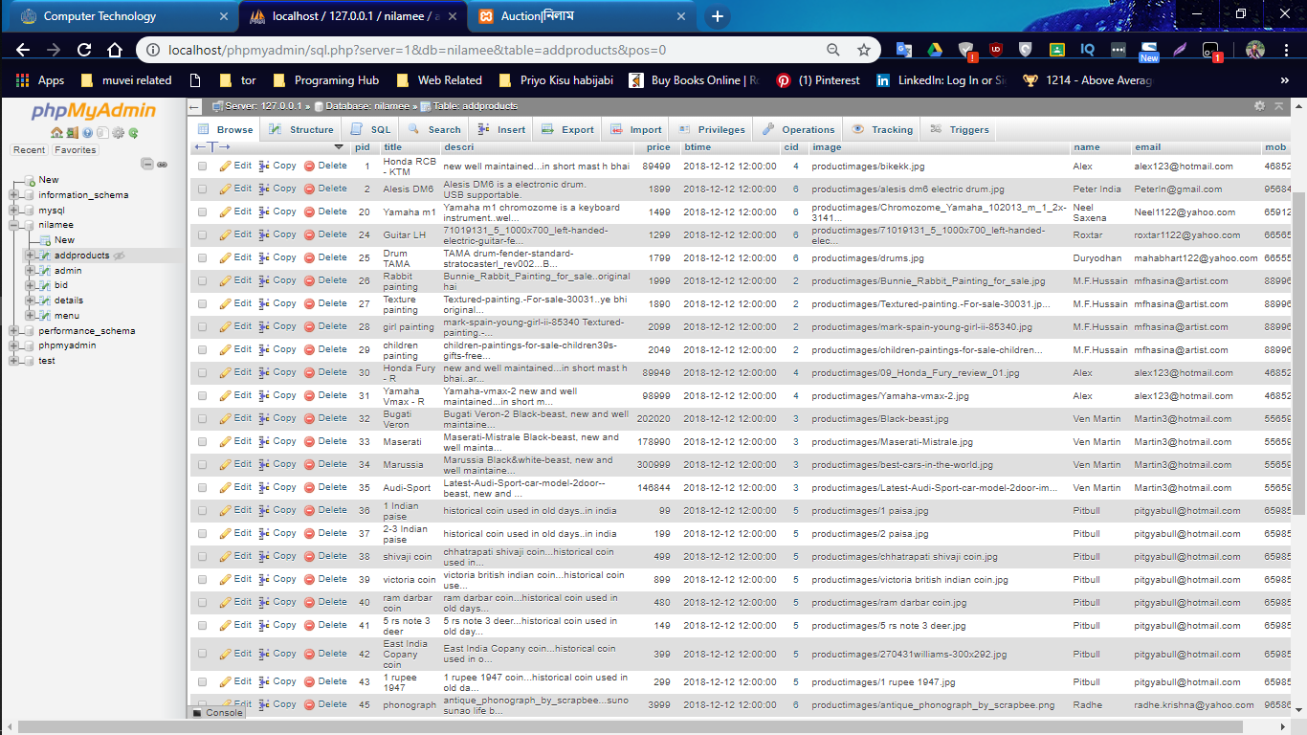
Purpose: Products Information Table
Description: This table will contain the products details information. This information will help to add new products and delete old products.

Slide 9
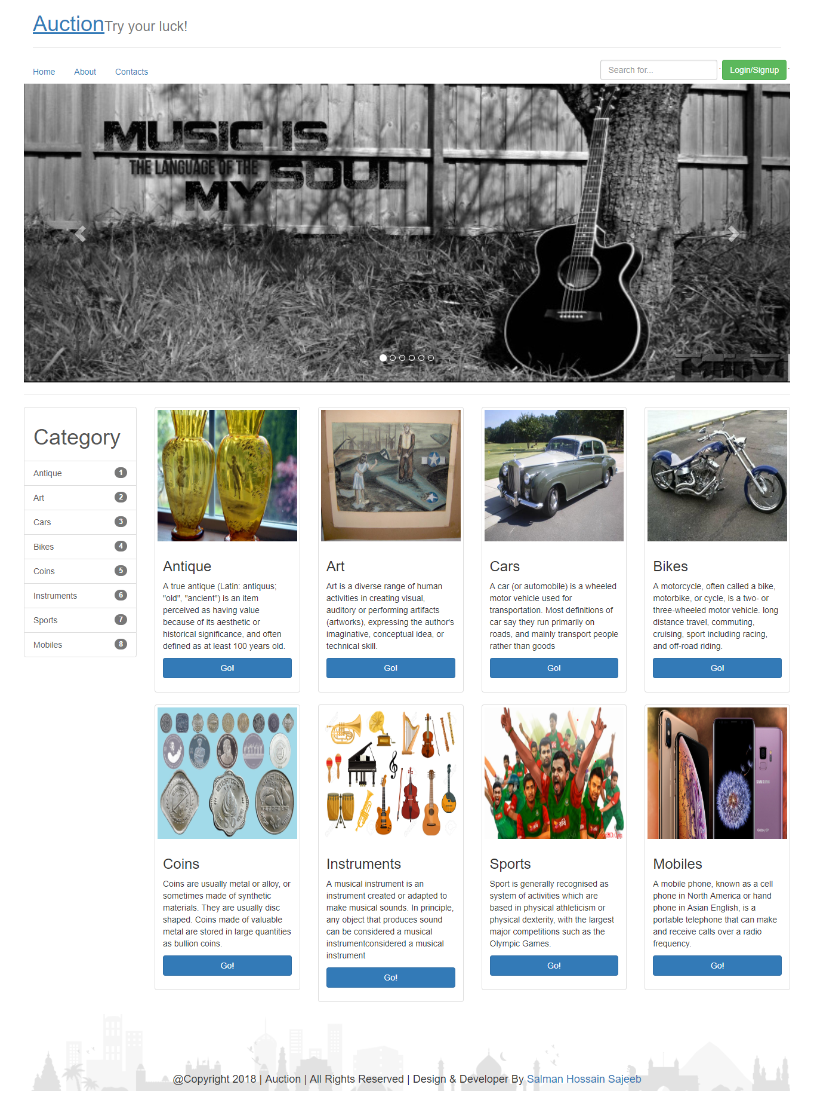
Design Interface
Home Page:

Slide 10
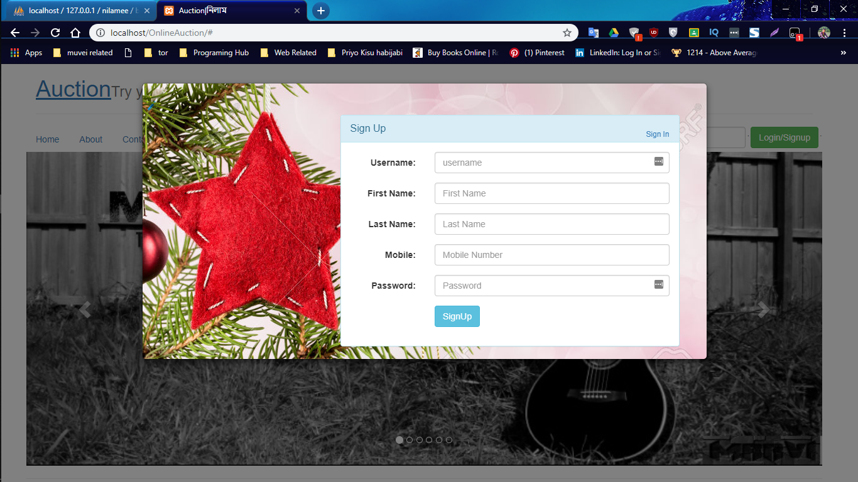
Sign Up Page:

Slide 11
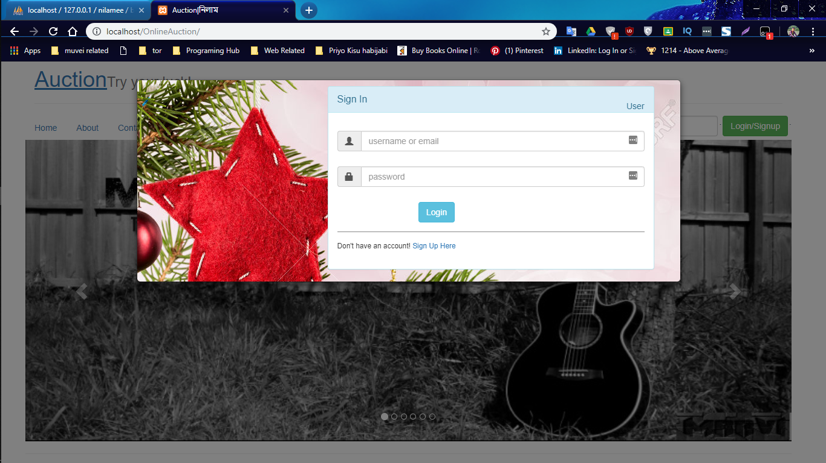
Sign in Page:

Slide 12
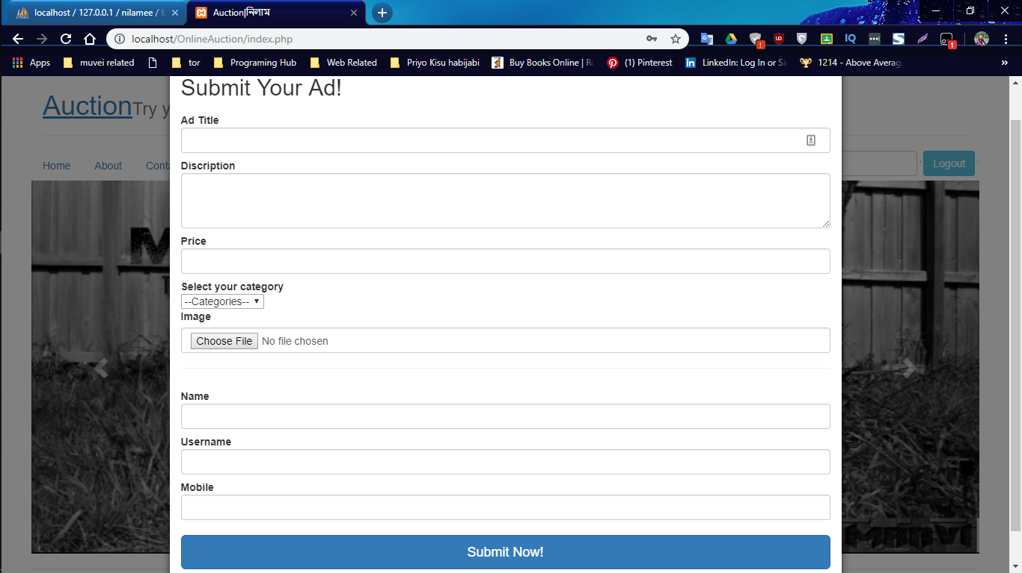
Sell A Product or Ad:
Description: Users can upload their product through this page to bid.

Slide 13
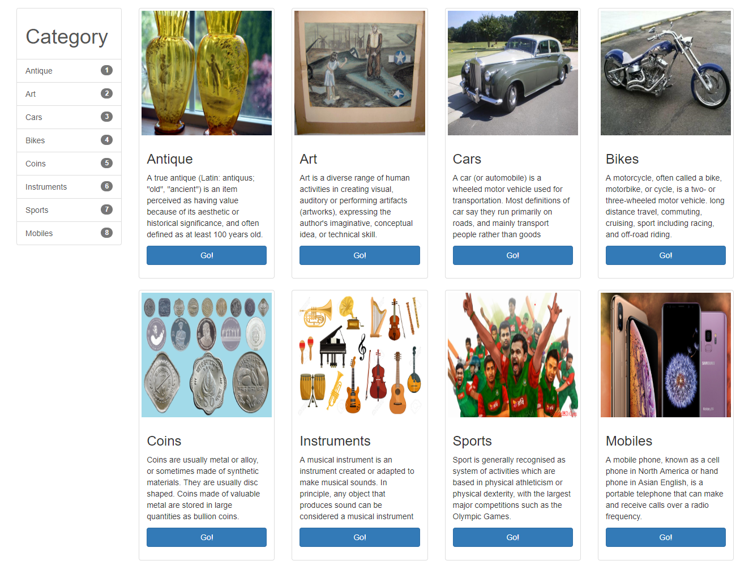
Category Page:

Slide 14
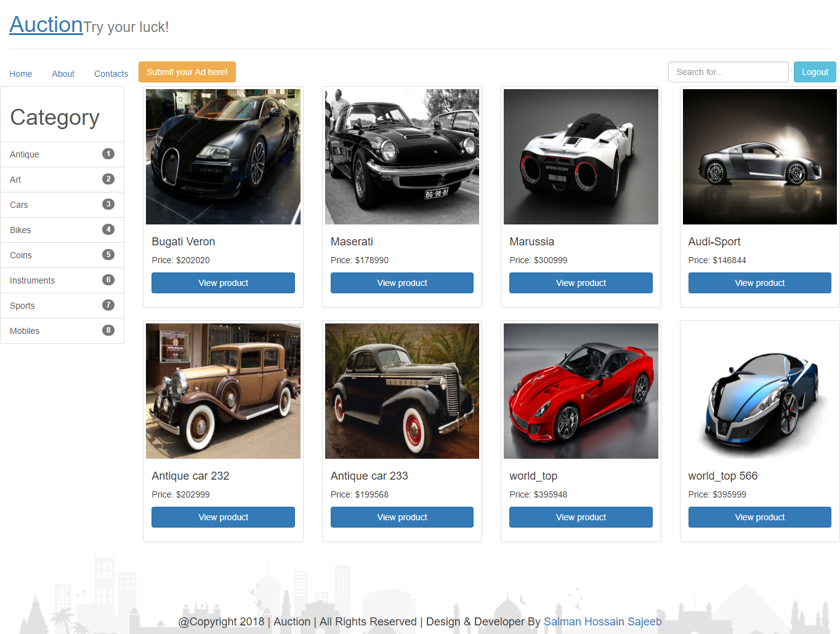
View Single Category Page:

Slide 15
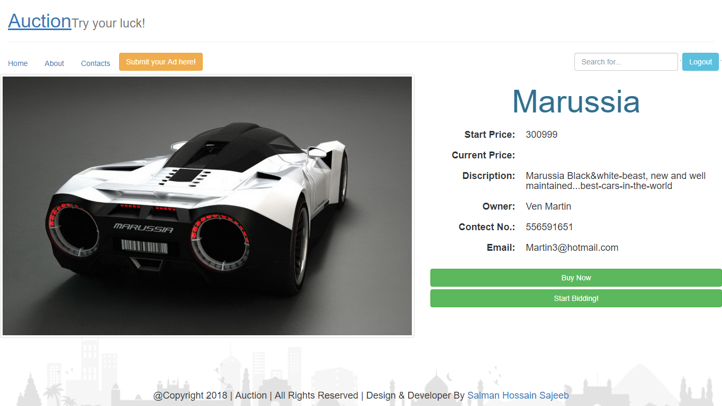
View Product & Biding:

Slide 16
Conclusion
An implementation of web auction with it’s own design and bid politics.
have an intuitive interface and unique visual objects
Common client operations were implemented in this application. In addition, there were used some original marketing solutions.

Slide 17
Thank You!

